Slide 1
Design of forward converter using TL431
By Stig Munk-Nielsen

Slide 2
Agenda
Buck – Forward converter
Switching waveforms
Current mode control
Control-to-output function Gvc: using ic = iL approximation
Control-to-output function GvFB (including trafo and shunt resistor)
Controller function: Type II
Summary behavior of V and I control
Simulation with TL431
Exercise

Slide 3
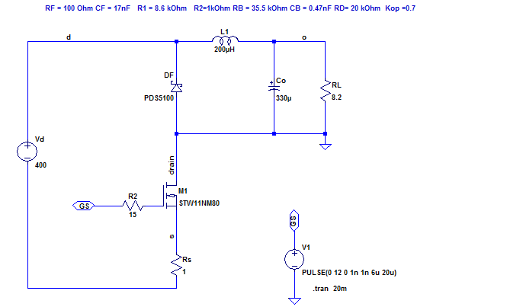
Buck Converter

Slide 4
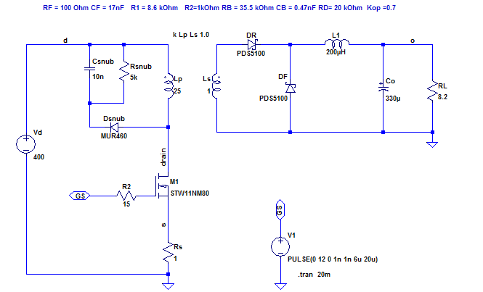
Forward Converter

Slide 5
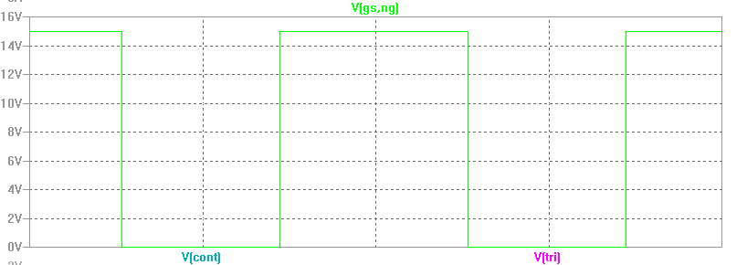
Forward type switching waveforms

Slide 6

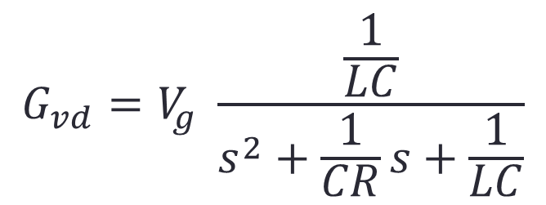


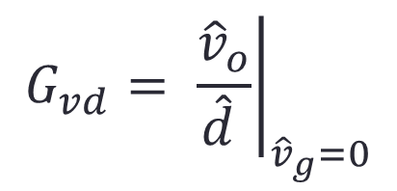

Voltage control: Control-to-Output function
$$\hat{d}$$
$${\hat{v}}_{o}$$
$Ls{\hat{i}}_{L}=V_{g}\hat{d}+{\hat{v}}_{g}$- ${\hat{v}}_{o}$
$$Cs{\hat{v}}_{o}={\hat{i}}_{L}−\frac{{\hat{v}}_{o}}{R}$$
$$G_{vd}$$
$$G_{vd}=V_{g} \frac{\frac{1}{LC}}{s^{2}+\frac{1}{CR}s+\frac{1}{LC}}$$
$$G_{vd}= {\left.\frac{{\hat{v}}_{o}}{\hat{d} }\right|}_{{\hat{v}}_{g}=0}$$

Slide 7
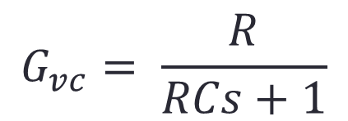


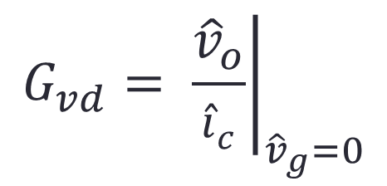

Current control: Control-to-Output function simple model: iL = ic
$${\hat{i}}_{c}$$
$${\hat{v}}_{o}$$
$Ls{\hat{i}}_{c}=V_{g}\hat{d}+{\hat{v}}_{g}$- ${\hat{v}}_{o}$
$$Cs{\hat{v}}_{o}={\hat{i}}_{c}−\frac{{\hat{v}}_{o}}{R}$$
$$G_{vc}$$
$$G_{vd}= {\left.\frac{{\hat{v}}_{o}}{{\hat{i}}_{c}}\right|}_{{\hat{v}}_{g}=0}$$
$$G_{vc}= \frac{R}{RCs+1}$$

Slide 8
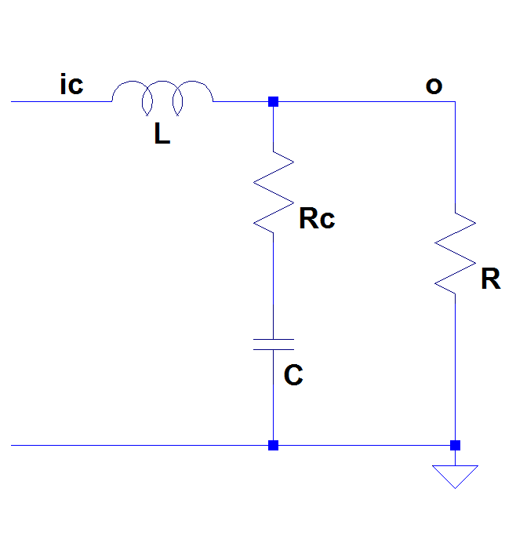
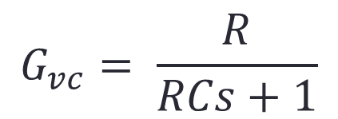
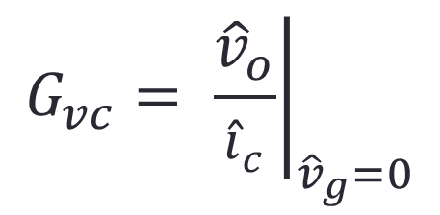
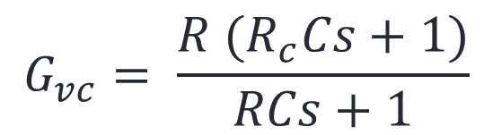


Control-to-output function including ESR in capacitor (Rc)
$${\hat{i}}_{c}$$
$${\hat{v}}_{o}$$
$${\hat{i}}_{c}$$
$$G_{vc}$$
$${\hat{v}}_{o}$$
$$G_{vc}= {\left.\frac{{\hat{v}}_{o}}{{\hat{i}}_{c}}\right|}_{{\hat{v}}_{g}=0}$$
+Rc
$$G_{vc}= \frac{R}{RCs+1}$$
$$G_{vc}= \frac{R (R_{c}Cs+1)}{RCs+1}$$

Slide 9
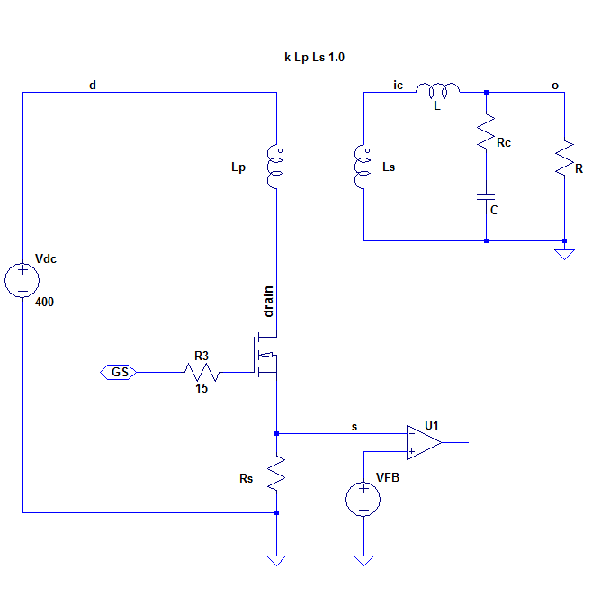
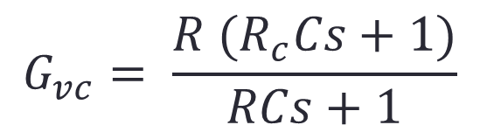
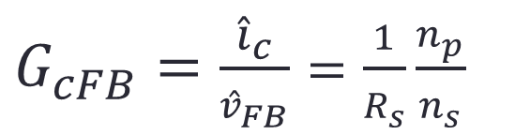






Control-to-output function including TRANSFORMER and Rs
$$G_{vc}= \frac{R (R_{c}Cs+1)}{RCs+1}$$
$${\hat{v}}_{FB}$$
$${\hat{v}}_{o}$$
$$G_{vFB}$$
$${\hat{i}}_{c}$$
$${\hat{v}}_{o}$$
$$G_{vFB}={G_{vc}G}_{cFB}$$
$G_{cFB}=\frac{{\hat{i}}_{c}}{{\hat{v}}_{FB}}=\frac{1}{R_{s}}\frac{n_{p}}{n_{s}}$
$${\hat{v}}_{FB}$$

Slide 10

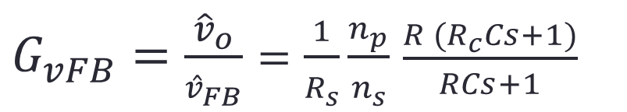


Control-to-output function including TRANSFORMER and Rs
$${\hat{v}}_{FB}$$
$${\hat{v}}_{o}$$
$$G_{vFB}$$
$${\hat{v}}_{o}$$
$G_{vFB}=\frac{{\hat{v}}_{o}}{{\hat{v}}_{FB}}=\frac{1}{R_{s}}\frac{n_{p}}{n_{s}}$ $\frac{R (R_{c}Cs+1)}{RCs+1}$
$${\hat{v}}_{FB}$$
$$G_{vFB}={G_{vc}G}_{cFB}$$

Slide 11
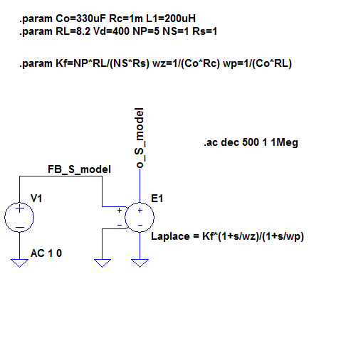
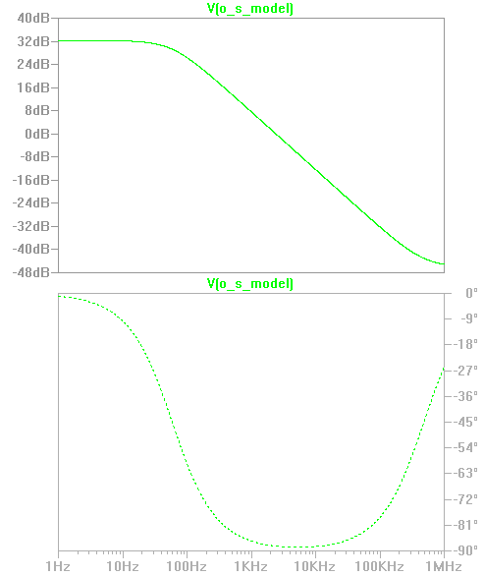
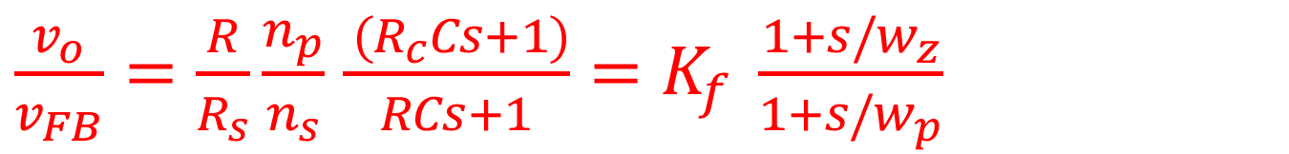
$\frac{v_{o}}{v_{FB}}=\frac{R}{R_{s}}\frac{n_{p}}{n_{s}}$ $\frac{ (R_{c}Cs+1)}{RCs+1}=K_{f} \frac{1+s/w_{z}}{1+s/w_{p}}$

Slide 12
So now we need the Controller : -)

Slide 13




What kind of behavior do we want from our Controller?
DC gain -> very high
Open Loop
OL:
$$f \left[Hz\right]$$
$$f_{c}$$
Close Loop
CL:
$$f \left[Hz\right]$$
$$f_{c}$$

Slide 14
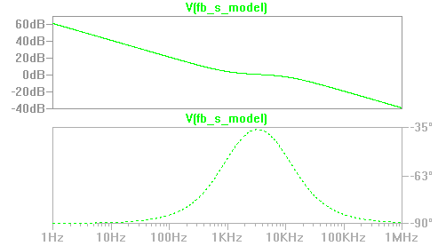



We can use a Type II network
$$\frac{1}{\frac{s}{wi} }$$
$$\frac{1}{(\frac{s}{wp1}+1)}$$
$$\left(\frac{s}{wz1}+1\right)$$

Slide 15
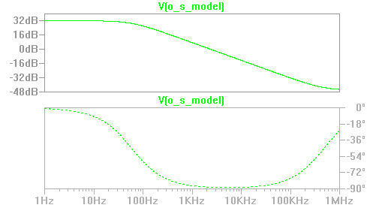


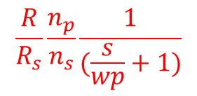


$$\frac{1}{\frac{s}{wi} }$$
$$\frac{1}{(\frac{s}{wpc}+1)}$$
$$\left(\frac{s}{wzc}+1\right)$$
$$\frac{R}{R_{s}}\frac{n_{p}}{n_{s}}\frac{1}{(\frac{s}{wp}+1)}$$
$$\left(\frac{s}{wz}+1\right)$$

Slide 16
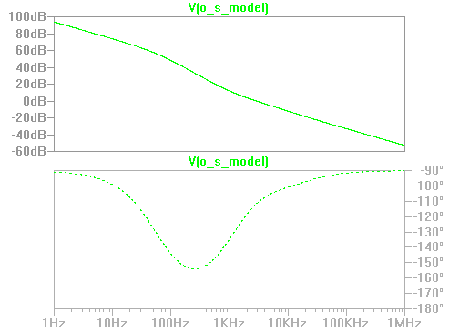


Tol is:
DC gain -> very high
Open Loop
OL:
$$f \left[Hz\right]$$
$$f_{c}$$

Slide 17
Summary behavior of V and I control

Slide 18






Block diagram: Current Programmed Control
$$G_{c}$$
$$G_{vFB}$$
$$v_{ref}$$
$$\frac{ (\frac{s}{wzc}+1)}{\frac{s}{wi}(\frac{s}{wpc}+1) }$$
$$\frac{R}{R_{s}}\frac{n_{p}}{n_{s}}\frac{\left(\frac{s}{wz}+1\right) }{(\frac{s}{wp}+1)}$$
$$\frac{ 1}{\frac{s}{wi} }\frac{R}{R_{s}}\frac{n_{p}}{n_{s}}$$
Notice : Tol – strongly depend on R

Slide 19

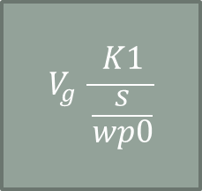


Block diagram: Voltage mode control
$$G_{c}$$
$$G_{vd}$$
$$v_{ref}$$
$$\frac{K1\left(\frac{s}{wz1}+1\right)(\frac{s}{wz2}+1)}{\frac{s}{wp0}(\frac{s}{wp1}+1)(\frac{s}{wp2}+1)}$$
$$V_{g} \frac{\frac{1}{LC}\left(\frac{s}{wz}+1\right)}{s^{2}+\frac{1}{CR}s+\frac{1}{LC}}$$
$$V_{g} \frac{K1}{\frac{s}{wp0}}$$
Notice : Tol – Only weakly depend on R
Notice: wp2 is a high frequency pole – from the O-amplifier
Notice : Tol – depend heavily on input voltage

Slide 20
Simulation with TL431

Slide 21
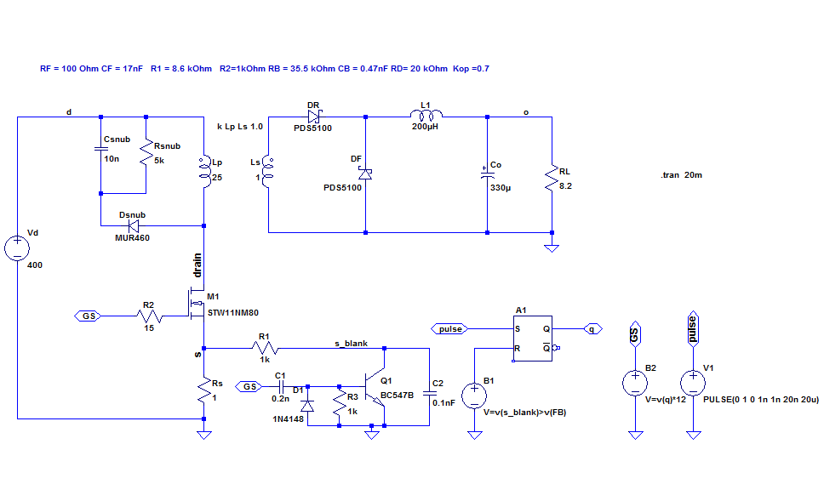
Shunt controller: TL431

Slide 22
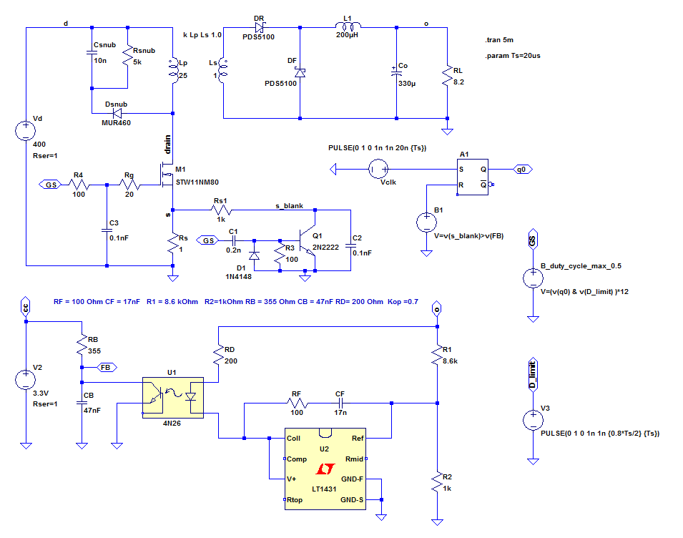

Slide 23
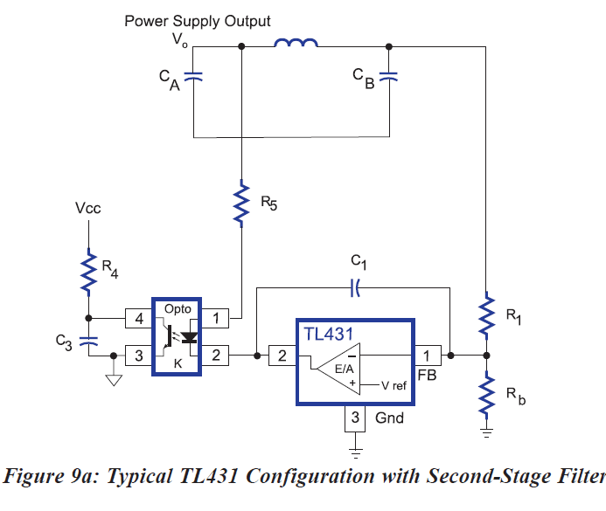
Ref: Designing with the TL431 Ray Ridley, Designer Series XV

Slide 24
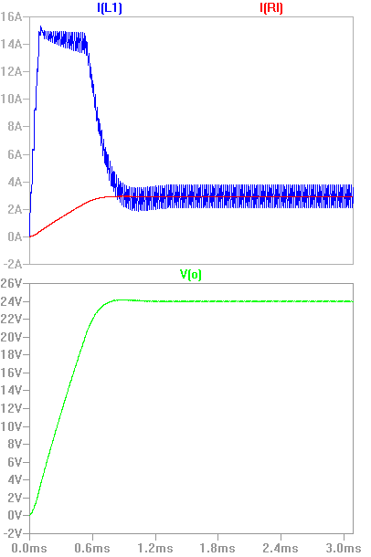
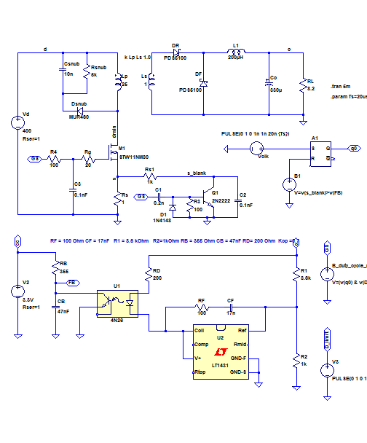

Slide 25
Exercise

